Slide 1
Visual Programming ADO.NET Architecture and Components

Slide 2
Building and Understanding .NET Core Web APIs
What is a Web API?
A Web API (Application Programming Interface) allows applications to communicate over the web using HTTP.
It exposes endpoints to perform CRUD operations on resources.
Commonly used in web, mobile, and desktop apps for server-side communication.

Slide 3
Overview of .NET Core Web API
ASP.NET Core provides tools to build RESTful APIs using controllers.
APIs return data (JSON/XML) instead of HTML views.
Lightweight and cross-platform.

Slide 4
RESTful API Principles and HTTP Methods
REST (Representational State Transfer): Architectural style for distributed systems.
HTTP Methods:
GET: Retrieve data
POST: Create new resource
PUT: Update entire resource
PATCH: Update part of a resource
DELETE: Remove resource

Slide 5
Setting up a .NET Core Web API project.
Open Visual Studio and select Create a new project.
Choose ASP.NET Core Web API template.
Click Next.
Name your project (e.g., WeatherApiDemo) and choose a location.
Choose .NET version (e.g., .NET 6 or 7).
Keep "Use controllers (uncheck minimal API)" checked.
Click Create.

Slide 6
Setting up a .NET Core Web API project.
Project Structure Overview
Controllers: Contains controller classes (e.g., WeatherController.cs).
Program.cs: Main file where services are registered and the app is configured.
appsettings.json: Configuration file (e.g., connection strings, API keys).
wwwroot: Public assets folder (if needed).
WeatherApp.csproj: Project file that defines dependencies and framework.
Explanation: This structure helps in separation of concerns, scalability, and maintainability.

Slide 7
Creating a controller
A Controller handles HTTP requests and returns responses.
Step-by-Step in Visual Studio:
Right-click the Controllers folder → Add → Controller.
Choose API Controller - Empty → Click Add.
Name your controller (e.g., WeatherController.cs).

Slide 8
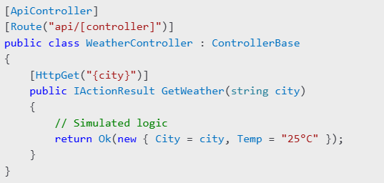
Creating a controller
Explanation
[ApiController]: Indicates this class responds to HTTP API requests.
[Route("api/[controller]")]: The route becomes /api/weather.
GetWeather handles GET requests like /api/weather?city=London.
FromQuery: Reads the city name from the query string.
return Ok(weather): Sends a 200 OK response with the weather data.
Error handling is done via BadRequest (400) and StatusCode (503) for better user feedback.

Slide 9
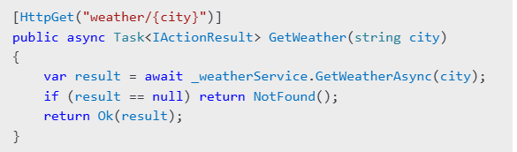
Implementing a GET Endpoint to Retrieve Data

Slide 10
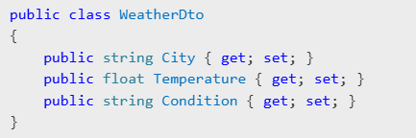
Data Models and Serialization
Defining Data Models (DTOs)
Data Serialization with JSON
.NET Core uses System.Text.Json for JSON serialization.
Converts C# objects to JSON and vice versa.
Content Negotiation
Automatically sends response in JSON or XML depending on request Accept header.

Slide 11
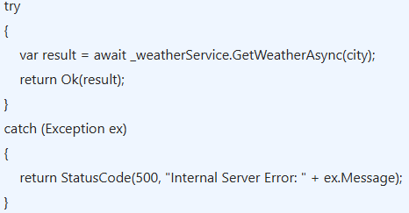
Error Handling and Status Codes
Handling Errors
Meaningful Status Codes
200 OK: Successful response
400 Bad Request: Invalid input
404 Not Found: Resource not found
500 Internal Server Error: Server-side error

Slide 12
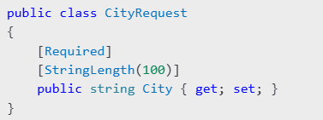

Request Validation and Authentication
Data Validation with Attributes
Use [ApiController] and model binding for auto-validation.
Authentication (JWT)
Add JWT support via Microsoft.AspNetCore.Authentication.JwtBearer.
Configure in Program.cs:
Securing Endpoints

